Slide 1
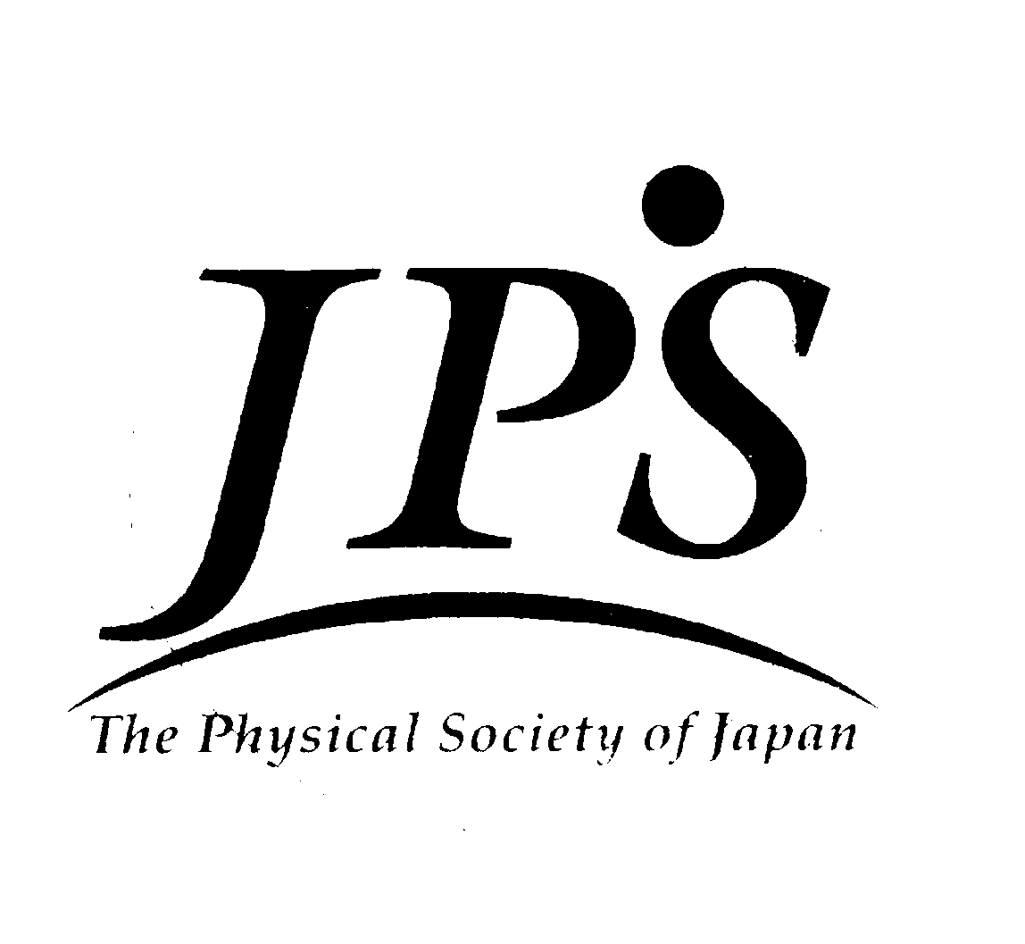
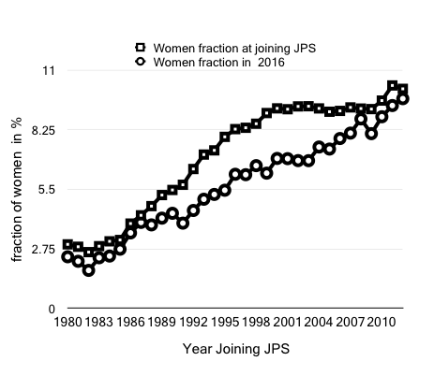
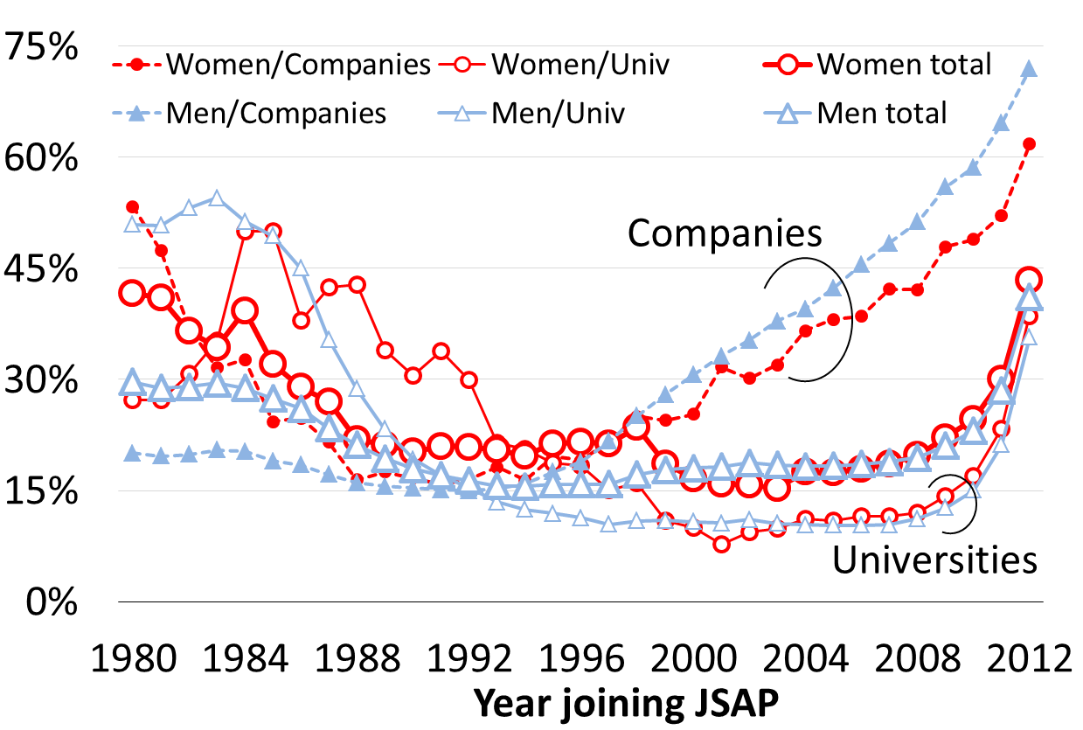
Women in Physics in Japan
APPC12WIP Japan, July 2013
Mihoko Nojiri ¹ , Nahoko Kasai ², Atsushi Masuda ², Nobuyuki Matsuki ² and Takami Tohyama ¹
¹ The Physical Society of Japan, ² The Physical Society of Applied Physics
JPS members:
Each year, more than 1500 new members join as new JPS members, and the ratio of women is typically ~10% since year 2000. Majority of the JPS members belong to either a university or a research institution. The distribution of the age of the new members peaks around 23~24 in the period 2001~2016. The member record covers significant Japanese physics researchers. JPS has decided to investigate them to study the gender inequality in Japan.
JSAP members:
Each year, about 2000 new members join as new JSAP members, and the ratio of women is typically 8~9% since year 2010. 50% of the JSAP members belong to universities, 3% national laboratories, and more than 40% companies. Women fractions are 4% for members in private companies, and 6% for those in universities. The member record covers both Japanese physics researchers and Japanese industries.
Leaky pipeline between graduate level to faculty level in Japan :
Figure 1 shows the fraction of the women by the year they joined JPS. In the upper line, the women ratio at the year joining JPS is given. Here we show the moving average for every 5 years. (We do not show the ratio by each year because the numbers of the women members are rather small.) The ratio increased significantly until 2000, but it remains around 10 % for the last 15 years. The lower line shows the ratio of the women members at the end of 2016 again by the year they became the JPS members. The ratio of the current women fraction divided by those at the year they joined is shown in Fig. 2. It is around 70 % for the group joined JPS between 1990 and 2003. The figure indicates lower ratio of women obtaining the academic career than men in JPS, although government aims for the higher ratio of women researchers. The higher ratio for those joined after 2003 does not mean the improved situation for women; it is more likely that the women members in the age group are still quitting much faster than men in the same age group.
Figure 1: Fraction of women member when they joined JSP and in 2016 by the year they joined JPS.
◆ Note: Women “deficit” with higher competition
Fraction of women have not been decreasing for those joining the JPS around mid 80’s. The generation gets PhD when there were relatively many open positions in the universities. Later in ‘90s, number of graduate students increased drastically, leading higher competition among those seeking research positions. Because of these external situations, the fraction of members who remain JPS today varies drastically with the year they joined the JPS. (See Fig. 3 (A)). It should be noted that the difference between men and women expanded in the period.
Figure 2: Fraction of women members divided by the fraction when they joined.
JPS
JSAP
◆ Interpretations
The significant in equivalence between men and women JPS members may have come from the social demand, the biased view, and the under-representation toward women researcher in Japan. However, the difference between men and women in career building starts earlier than graduate level in Japan, namely, in the education in high school level or earlier. For example, women fraction is lower in more competitive universities in Japan; recent statistics shows that the women ratio 44% in all Japanese universities, while it is around 20% for the two most competitive ones. This low women ratio indicates that experiences and human network may be limited for average women graduate students.
◆ JSAP
The Japan Society of Applied Physics (JSAP) member records were also analyzed to examine the differences due to members’ affiliation, either industries or academia. Although the survival rates of total averages showed similar tendency to those of JPS, women survived a little more than men who entered JSAP in 80s-90s (Fig. 3 (B)). Interestingly, the survival rates for company members were significantly higher than those of the total average for the member who entered JSAP after 2000, however the gender difference for company members was large; less women survived than men. These results indicates that women members in companies still had difficulty in continuing the research due to their life events and/or transfer. Thus, the company member records in JSAP may reflect gender equality in Japanese industrial environment.
Figure 3. Fraction of current men and women members among those joined in the year indicated in the horizontal axis in JPS (A) and JSAP (B).

